Slide 1
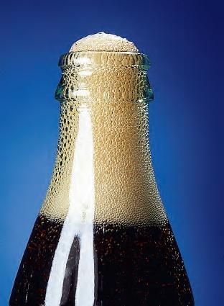
Solution and Colligative Properties

Slide 2
Solution and Colligative Properties
Solution Formation
Types of Solutions
Solubility and the Solution Process
Effects of Temperature and Pressure on Solubility
Colligative Properties
Ways of Expressing Concentration
Vapor Pressure of a Solution
Boiling-Point Elevation and Freezing- Point Depression Osmosis
Colligative Properties of Ionic Solutions
Colloid Formation
Colloids

Slide 3
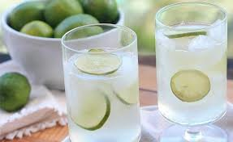
Solution: Definition
Homogeneous
Mixture
Mixture of two or more constituents
can not separated by mechanical treatment
সরবত
Homogeneous Mixture
Heterogeneous Mixture
(Coarse mixture)
Mechanical treatment
Colloid
True Solution
Notes:
The term solution is used in our everyday life and seems it needs no explanation. ‘Sarabot’ –very popular sweet drinks in summer time- is the mixture of sugar, water and lemon. Thus solution can be defined as the mixture of two or more constituents. Let us find whether this definition is sufficient or not.
Mixture is another daily life word. A mixture is a material system made up of two or more different substances. For example: mixture of brick, cement and sand in concrete. Then what is the difference between mixture and solution? There are two kind of mixture: Homogeneous and Heterogeneous. In homogenous mixture the composition is same anywhere of the mixture. On the other hand in heterogeneous mixture the composition is not uniform throughout the mixture. Solution is a homogenous mixture by definition. [Sometimes the heterogeneous mixtures are termed as coarse mixture, when the constituents are seen in necked eye.]

Slide 4
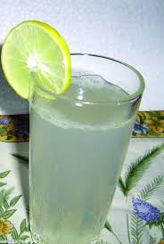
Pick 10 molecules of solution from different part of the solution
Number of water and sugar molecules from every part of the solution is same
????
The answer is NO
judgment of molecular level a solution is not homogeneous but homogeneous in macroscopic level
What is the difference between a molecule and a solution?
In solution the composition can be varies up to a certain level but this is not in the case of molecule
Solution is a homogeneous mixture whose composition can be varied up to a certain limit and whose constituents can not be separated by mechanical means

Slide 5
Types of solution
Substance that dissolves as solute and the substance in which solution takes place as the solvent
Depends on the three physical state of matter there are different way of combination to form the binary solution. The number of possible binary solutions that may be expected from the three states of matter.
Gas in Gas : Air
Gas in Liquid : Carbonated drinks
Gas in Solid : Hydrogen in palladium
Liquid in Gas : Fog
Liquid in Liquid : Water-alcohol
Liquid in Solid : liquid benzene in solid iodine
Solid in Gas : Smoke
Solid in Liquid : NaCl in water
Solid in Solid : Brass

Slide 6
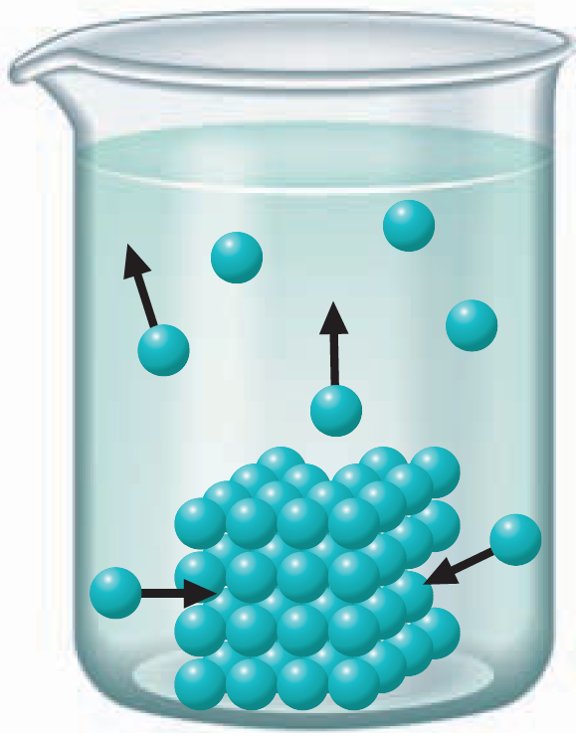
Solubility and the Solution Process
Solubility equilibrium
The solid crystalline phase is in dynamic
equilibrium with species (ions or molecules)
in a saturated solution. The rate at which
species leave the crystals equals the rate
at which species return to the crystals.
The solubility of sodium chloride in water (the amount that dissolves in a given quantity of water at a given temperature to give a saturated solution) is 36.0 g/100 mL at 20ºC.
Saturated solution – a solution that is in equilibrium with respect to a given dissolved substance.
Unsaturated solution – a solution not in equilibrium with respect to a given dissolved substance and in which more of the substance can dissolve.
Supersaturated solution – a solution that contains more dissolved substance than a saturated solution does.

Slide 7
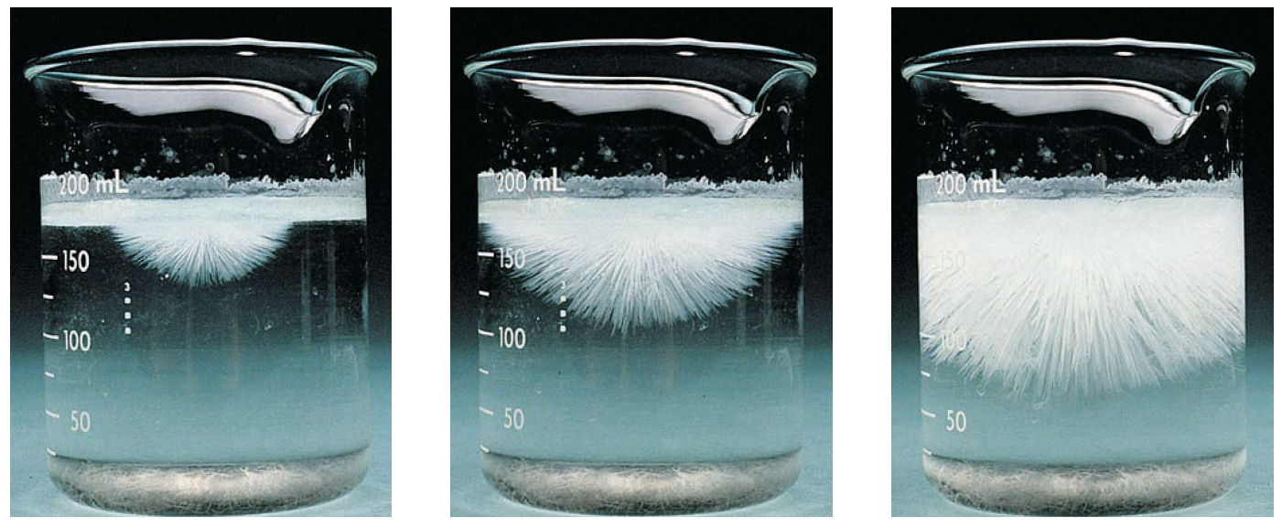
Supersaturated Solution: Crystallization
Crystallization from a supersaturated solution of sodium acetate
Left: Crystallization begins to occur when a small crystal of sodium acetate is added.
Center, right: Within seconds, crystal growth spreads from the original crystal throughout the solution

Slide 8
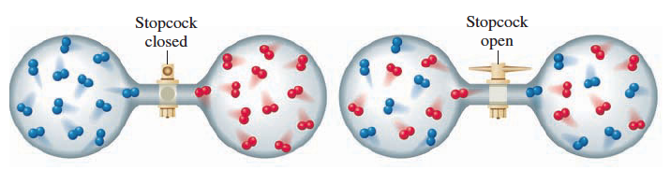
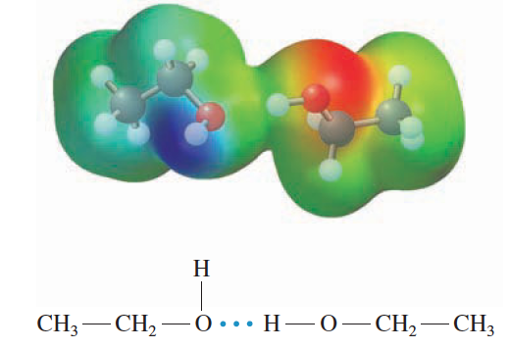
Factors in Explaining Solubility
“like dissolves like”
Two factors involved in solubility:
Natural tendency toward disorder.
Relative forces of attraction between species
(Hydrogen bonding between water
and ethanol molecules)

Slide 9
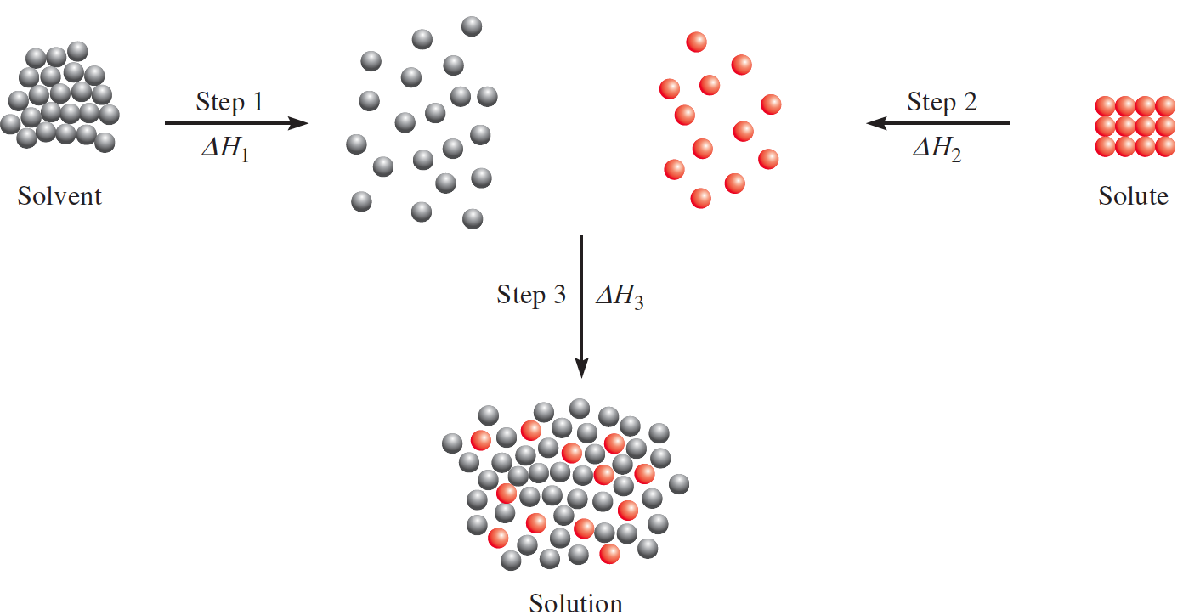
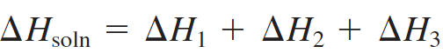
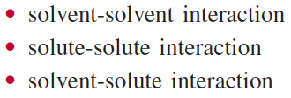
A Molecular View of the Solution Process
If the solute-solvent attraction is stronger than the solvent-solvent attraction and solute-solute attraction, the solution process is favorable; that is, it is exothermic
(ΔH_{soln} < 0).
If the solute-solvent interaction is weaker than the solvent-solvent and solute-solute interactions, the solution process is endothermic (ΔH_{soln} > 0).

Slide 10
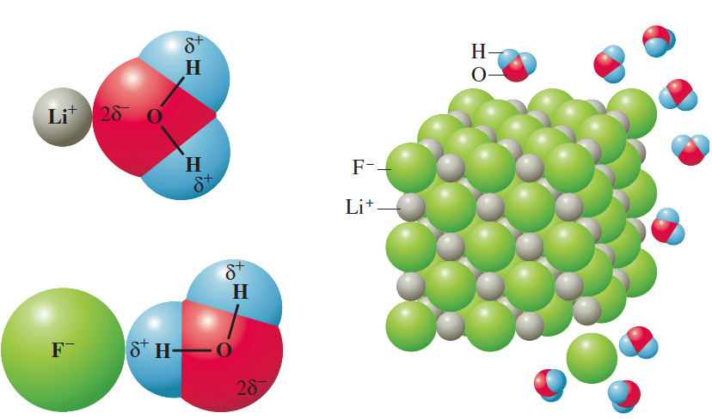
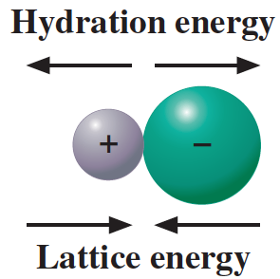
Ionic Solutions
The energy of attraction between an ion and a water molecule is due to ion–dipole force.
The attraction of ions for water molecules is called hydration. Hydration of ions favors the dissolving of ionic solid in water.
lattice energy, the energy holding ions together in the crystal lattice. Lattice energy works against the solution process.
Hydration energy pulls ions apart, whereas the lattice energy keeps the ions together. If the lattice energy is large relative to the hydration energy, the ions are likely to remain together, resulting in an insoluble compound.

Slide 11
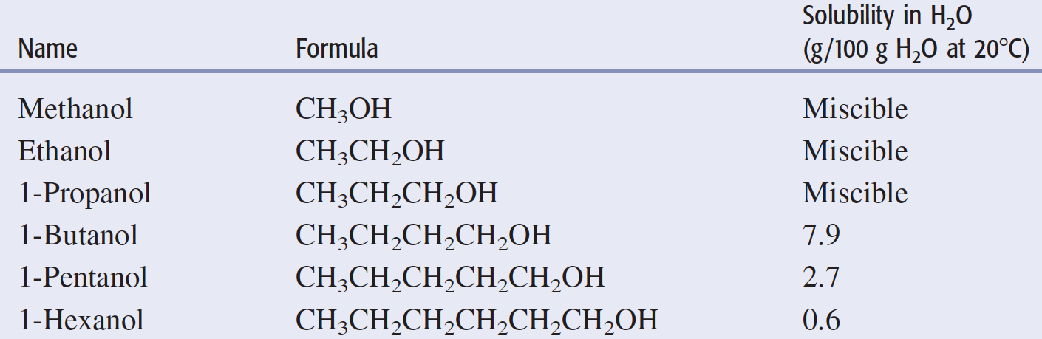
Solubility of Alcohol in Water
Which of the following compounds is likely to be more soluble in water: C₄H₉OH or C₄H₉SH? Explain.

Slide 12
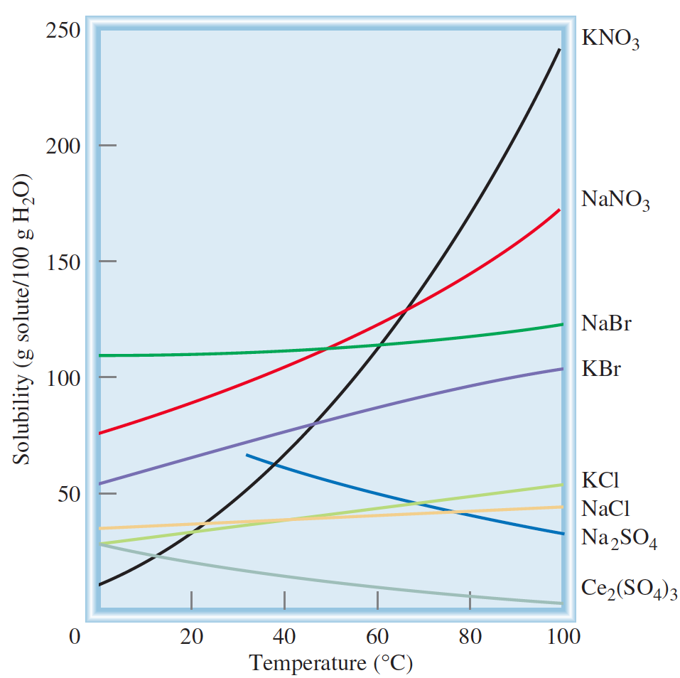
Effects of Temperature on Solubility

Slide 13
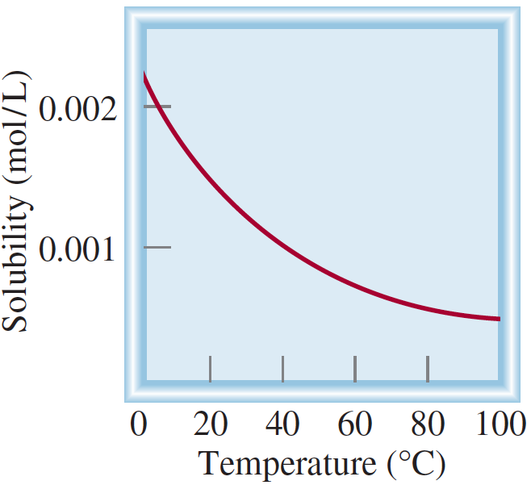
Gas Solubility and Temperature
The reduced solubility of molecular oxygen in hot water has a direct bearing on thermal pollution, that is, the heating of the environment—usually waterways—to temperatures that are harmful to its living inhabitants.
Fish, like all other cold-blooded animals, have much more difficulty coping with rapid temperature fluctuation in the environment than humans do. An increase in water temperature accelerates their rate of metabolism, which generally doubles with each 10°C rise. The speedup of metabolism increases the fish’s need for oxygen at the same time that the supply of oxygen decreases because of its lower solubility in heated water.
Dependence on temperature of the solubility of O₂ gas in water. Note that the solubility decreases as temperature increases. The pressure of the gas over the solution is 1 atm.

Slide 14
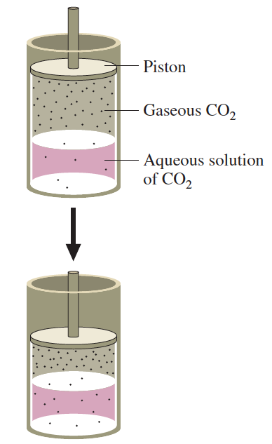
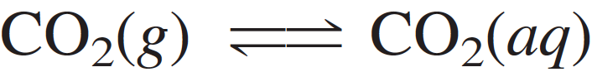
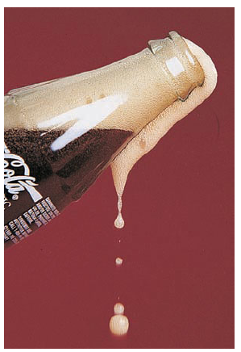
Effects of Pressure on Solubility
Sudden release of pressure from a carbonated beverage

Slide 15
Henry’s Law: Relating Pressure to the Solubility of a Gas in a Liquid
The effect of pressure on the solubility of a gas in a liquid can be predicted quantitatively. According to Henry’s law, the solubility of a gas is directly proportional to the partial pressure of the gas above the solution.
S = k_{H}P
where S is the solubility of the gas (expressed as mass of solute per unit volume of solvent), k_{H} is Henry’s law constant for the gas for a particular liquid at a given temperature, and P is the partial pressure of the gas.

Slide 16
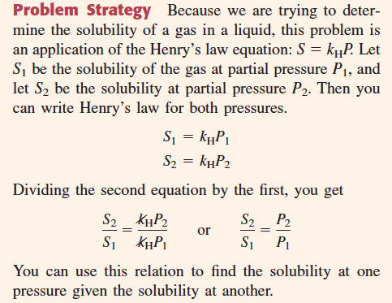
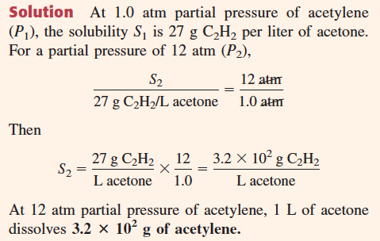
Henry’s Law
27 g of acetylene, C₂H₂, dissolves in 1 L of acetone at 1.0 atm pressure. If the partial pressure of acetylene is increased to 12 atm, what is its solubility in acetone?

Slide 17
Colligative Properties
Colligative properties of solutions are properties that depend on the concentration of solute molecules or ions in solution but not on the chemical identity of the solute.
Colligative properties are:
Vapor pressure lowering
Boiling-Point Elevation and Freezing-Point Depression
Osmotic Pressure

Slide 18
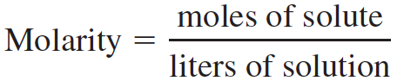
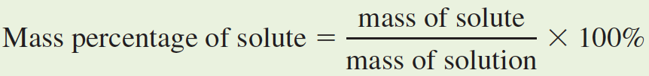
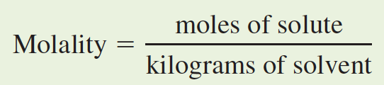
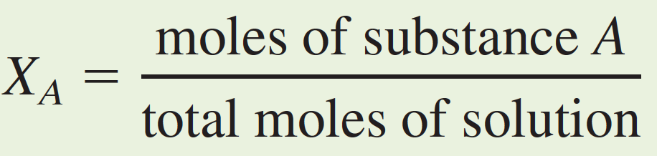
Ways of Expressing Concentration
molarity of a solution is the moles of solute in a liter of solution.
mass percentage of solute is the percentage by mass of solute contained in a solution.
molality of a solution is the moles of solute per kilogram of solvent.
mole fraction of a component substance A (X_{A}) in a solution is defined as the moles of component substance divided by the total moles of solution (that is, moles of solute plus solvent).

Slide 19
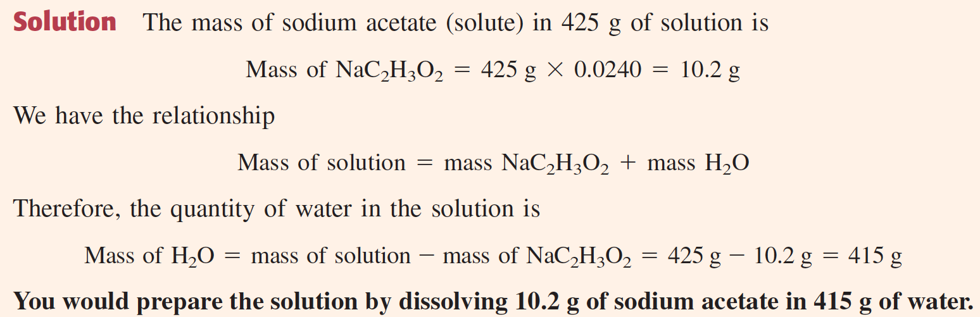
How would you prepare 425 g of an aqueous solution containing 2.40% by mass of sodium acetate, NaC₂H₃O₂?

Slide 20
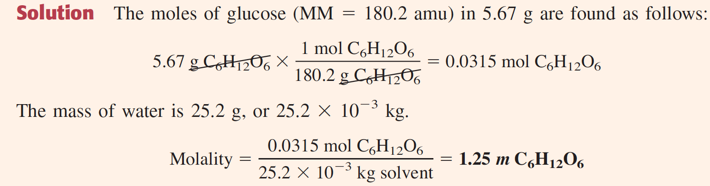
Glucose, C₆H₁₂O₆, is a sugar that occurs in fruits. It is also known as “blood sugar” because it is found in blood and is the body’s main source of energy. What is the molality of a solution containing 5.67 g of glucose dissolved in 25.2 g of water?

Slide 21
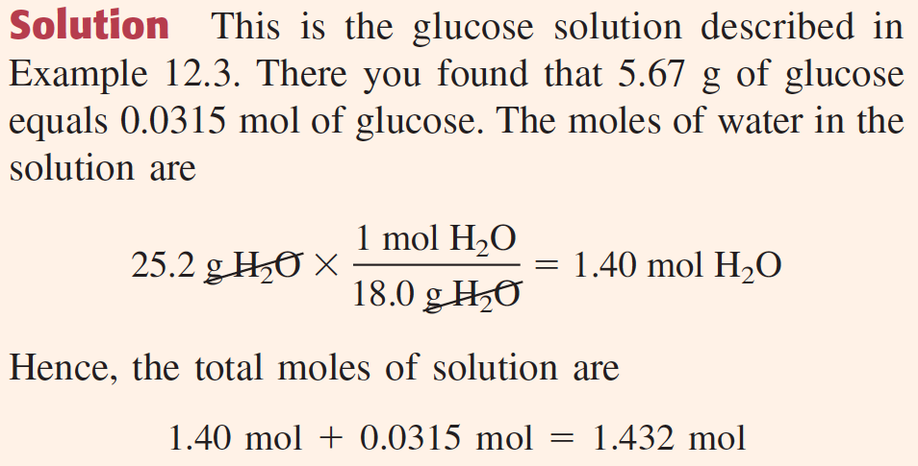
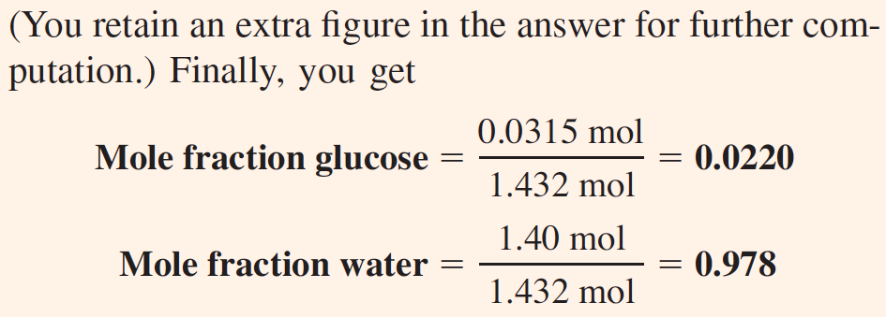
What are the mole fractions of glucose and water in a solution containing 5.67 g of glucose, C₆H₁₂O₆, dissolved in 25.2 g of water?

Slide 22
Vapor Pressure of a Solution
Vapor-pressure lowering of a solvent is a colligative property equal to the vapor pressure of the pure solvent minus the vapor pressure of the solution.
Consider a solution of volatile solvent, A, and nonelectrolyte solute, B, which may be volatile or nonvolatile. According to Raoult’s law, the partial pressure of solvent, P_{A}, over a solution equals the vapor pressure of the pure solvent, Pº_{A}, times the mole fraction of solvent, X_{A}, in the solution.
In general, Raoult’s law is observed to hold for dilute solutions—that is, solutions in which X_{A} is close to 1. The vapor-pressure lowering, ΔP, is
Substituting Raoult’s law gives
But the sum of the mole fractions of the components of a solution must equal 1; that is, X_{A} + X_{B} = 1. So X_{B} = 1 - X_{A}. Therefore,

Slide 23
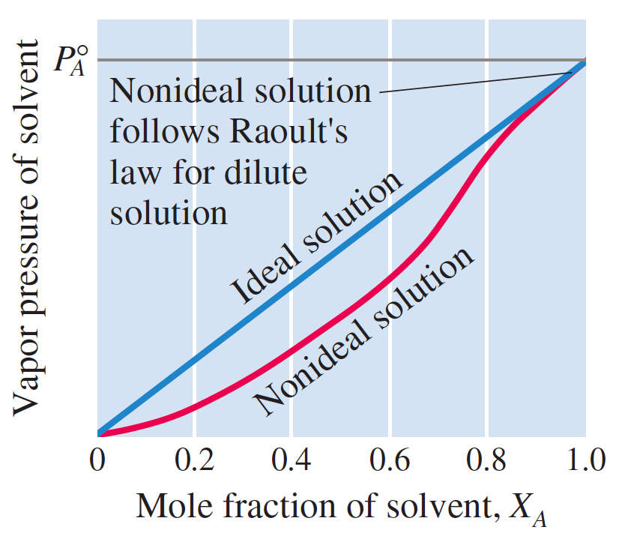
Raoult’s Law: Ideal & Nonideal Solution

Slide 24
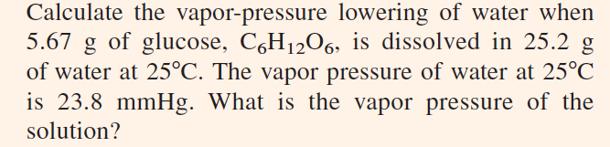
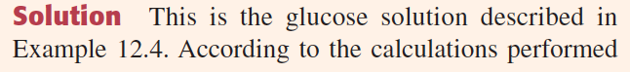
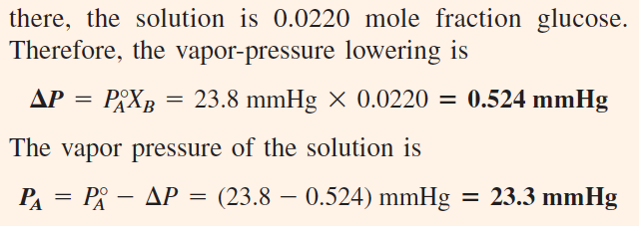

Slide 25
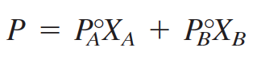
Raoult’s Law: Ideal & Nonideal Solution
An ideal solution of substances A and B is one in which both substances follow Raoult’s law for all values of mole fractions. Such solutions occur when the substances are chemically similar so that the intermolecular forces between A and B molecules are similar to those between two A molecules or between two B molecules.
Therefore, the total vapor pressure over an ideal solution equals the sum of the partial vapor pressures, each of which is given by Raoult’s law:

Slide 26
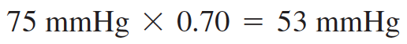
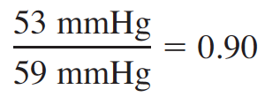
Ideal Solution
Solutions of benzene, C₆H₆, and toluene, C₆H₅CH₃, are ideal.
Suppose a solution is 0.70 mole fraction benzene and 0.30 mole fraction toluene. The vapor pressures of pure benzene and pure toluene are 75 mmHg and 22 mmHg, respectively. Hence, the total vapor pressure is
The vapor over this solution is richer in the more volatile component (benzene). The partial vapor pressure of benzene over the solution is
Because the total vapor pressure is 59 mmHg, the mole fraction of benzene in the vapor is
The vapor is 0.90 mole fraction benzene, whereas the liquid solution is 0.70 mole fraction benzene.
The vapor over a solution is richer in the more volatile component

Slide 27
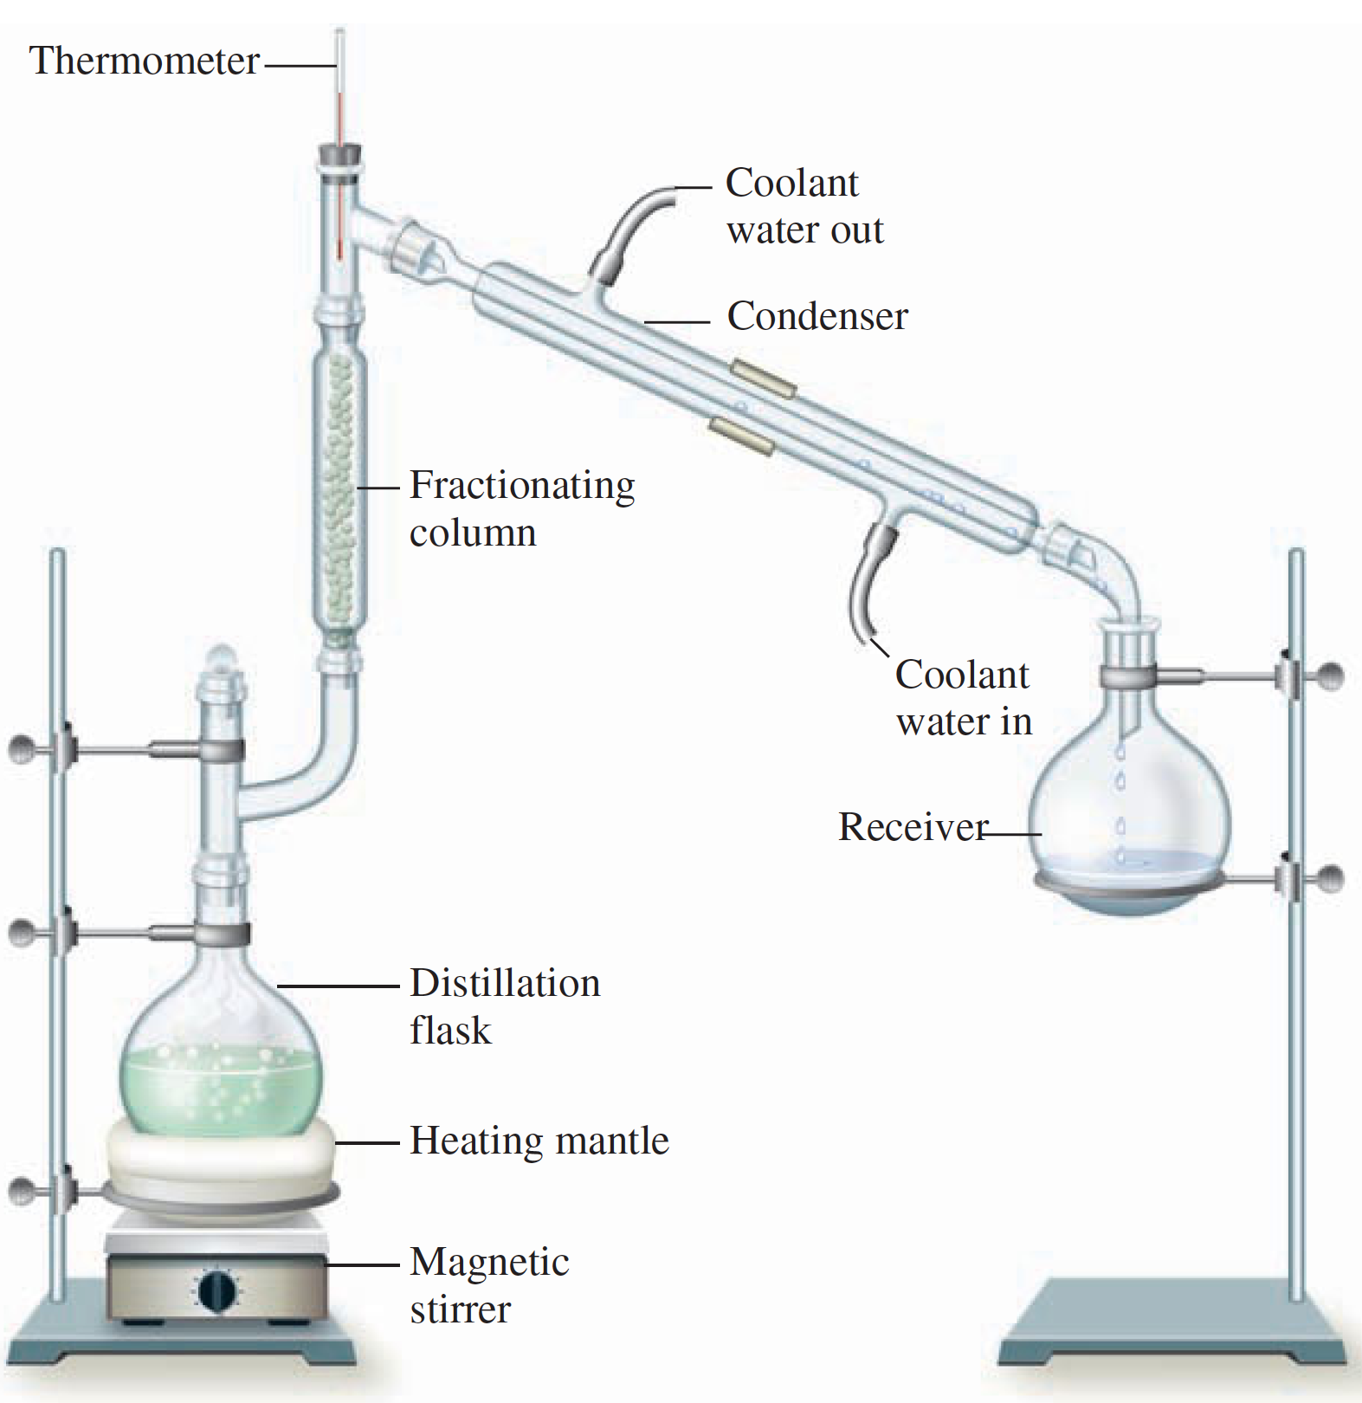
Fractional Distillation
If you distill a mixture of benzene and toluene, the vapor and the resulting
liquid that distills over will be richer in benzene, the more volatile component. If you then take this distillate and distill it, the vapor and the resulting liquid that comes over will be even richer in benzene. After many such distillations, you can obtain nearly pure benzene.
In practice, instead of actually performing a series of simple distillations to separate
the volatile components of a mixture, you perform a single fractional distillation
using a fractionating column, such as the one shown in Figure.

Slide 28
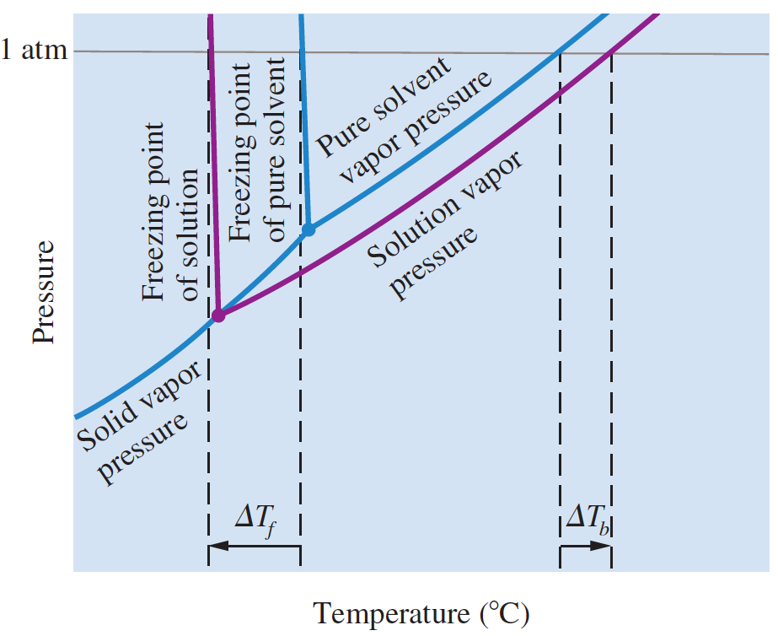
Ideal Solution

Slide 29
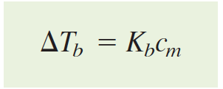
Boiling-Point Elevation
The boiling-point elevation, ΔT_{b}, is a colligative property of a solution equal to the boiling point of the solution minus the boiling point of the pure solvent.
The boiling-point elevation, ΔT_{b}, is found to be proportional to the molal concentration, c_{m}, of the solution (for dilute solutions).
The constant of proportionality, K_{b} (called the boiling-point-elevation constant), depends only on the solvent

Slide 30
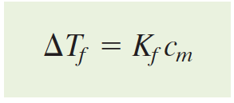
Ideal Solution
The freezing point depression, ΔTf, is a colligative property of a solution equal to the freezing point of the pure solvent minus the freezing point of the solution.
Freezing-point depression, ΔT_{f}, like boiling-point elevation, is proportional to the molal concentration, cm (for dilute solutions).
Here K_{f} is the freezing-point-depression constant and depends only on the solvent.

Slide 31
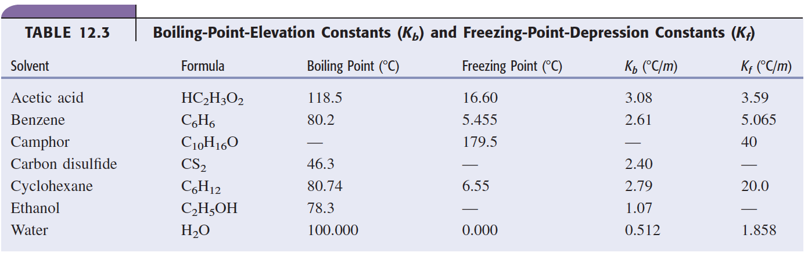

Slide 32
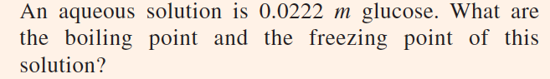
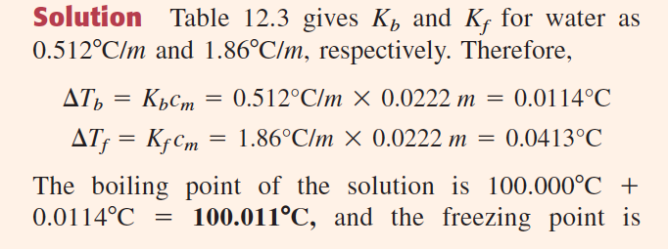
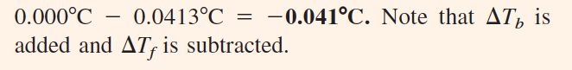

Slide 33
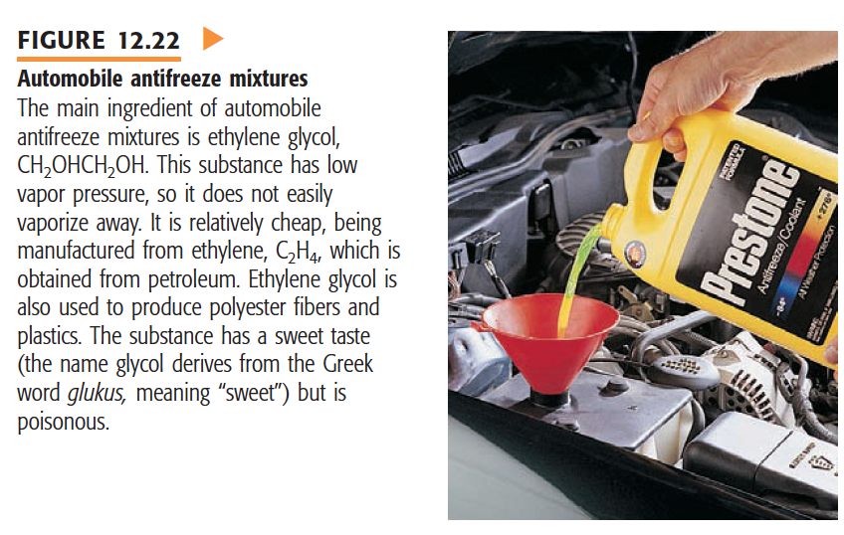

Slide 34
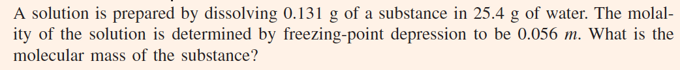
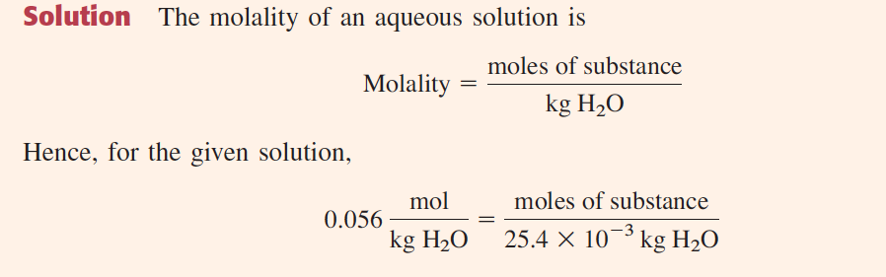
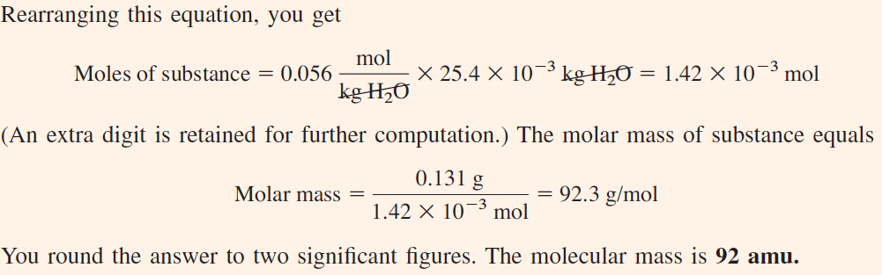

Slide 35
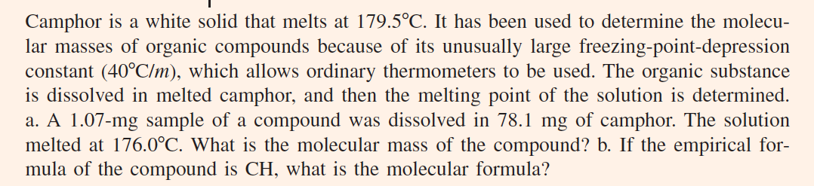

Slide 36
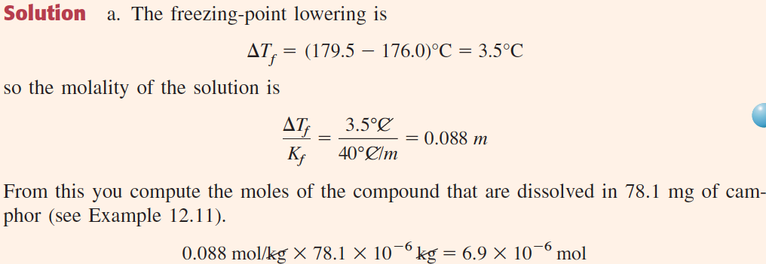
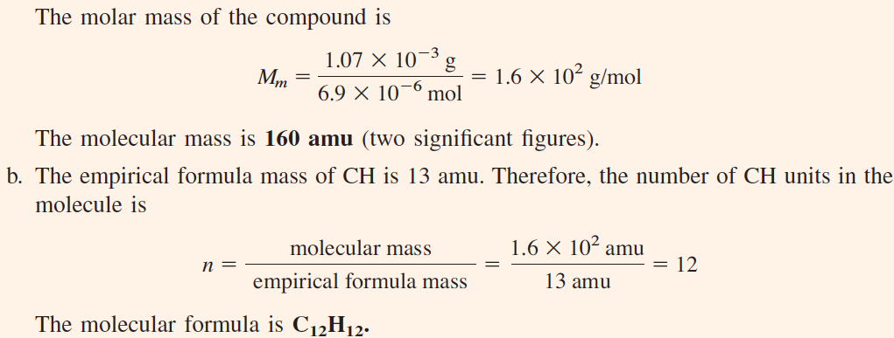

Slide 37

Osmosis
Osmosis is the phenomenon of solvent flow through a semipermeable membrane to equalize the solute concentrations on both sides of the membrane.
When two solutions of the same solvent are separated by a semipermeable membrane, solvent molecules migrate through the membrane in both directions. However, the solvent migration is faster from the solution of low concentration to the solution of high concentration.

Slide 38
Osmosis
Osmotic pressure is a colligative property of a solution equal to the pressure that, when applied to the solution, just stops osmosis.
The osmotic pressure, π, of a solution is related to the molar concentration of solute, M:
π = MRT
Here R is the gas constant and T is the absolute temperature.
There is a formal similarity between this equation for osmotic pressure and the equation for an ideal gas:
PV = nRT
The molar concentration M of a gas equals n/V; therefore, P = (n/V)RT = MRT.

Slide 39

The formula for low-molecular-mass starch is (C₆H₁₀O₅)_{n}, where n averages 200. When 0.798 g of starch is dissolved in 100.0 mL of water solution, what is the osmotic pressure, in mmHg, at 25 ºC?

Slide 40

Colligative Properties of Ionic Solutions

Slide 41

Colligative Properties of Ionic Solutions
The value of i equal to ΔT_{f} /K_{f} cm is often called the van’t Hoff factor.
Thus, the van’t Hoff factor for 0.029 m K₂SO₄ is 2.6.
At first, this was taken as evidence that salts were not completely ionized in solution. In 1923, however, Peter Debye and Erich Hückel were able to show that the colligative properties of salt solutions could be explained by assuming that the salt is completely ionized in solution but that the activities, or effective concentrations, of the ions are less than their actual concentrations as a result of the electrical interactions of the ions in solution.

Slide 42


Estimate the freezing point of a 0.010 m aqueous solution of aluminum sulfate, Al₂(SO₄)₃. Assume the value of i based on the formula of the compound.

Slide 43
Colloids
A colloid is a dispersion of particles of one substance (the dispersed phase) throughout another substance or solution (the continuous phase).
Fog is an example of a colloid: it consists of very small water droplets (dispersed phase) in air (continuous phase).
A colloid differs from a true solution in that the dispersed particles are larger than normal molecules, though they are too small to be seen with a microscope.
The particles range from about 1 × 10³ pm (1 nm) to about 2 × 10⁵ pm (200 nm) in size.
Although a colloid appears to be homogeneous because the dispersed particles are quite small, it can be distinguished from a true solution by its ability to scatter light.

Slide 44
Why the Sky is Blue?
Although all gases and liquids scatter light, the scattering from a true solution is quite small and usually not detectable.
However, because of the considerable depth of the atmosphere (500 km), the scattering of light by air molecules can be seen.
The blue color of the sky is due to the fact that blue light is scattered more easily than red light.

Slide 45
Colloids: Tyndall Effect
The scattering of light by colloidal-size particles is known as the Tyndall effect.
For example, the atmosphere appears to be a clear gas, but a ray of sunshine against a dark background shows up many fine dust particles by light scattering.
Similarly, when a beam of light is directed through clear gelatin (a colloid, not a true solution), the beam becomes visible by the scattering of light from colloidal gelatin particles.

Slide 46

Colloids: Tyndall Effect
The scattering of light by colloidal-size particles is known as the Tyndall effect.
The vessel on the left contains a colloid, which scatters light. The vessel on the right contains a true solution, which scatters negligible light.

Slide 47

Types of Colloids

Slide 48
Hydrophilic and Hydrophobic Colloids
Colloids in which the continuous phase is water are divided into two major classes: hydrophilic colloids and hydrophobic colloids.
A hydrophilic colloid is a colloid in which there is a strong attraction between the dispersed phase and the continuous phase (water).
Many such colloids consist of macromolecules (very large molecules) dispersed in water. Except for the large size of the dispersed molecules, these colloids are like normal solutions.
Protein solutions, such as gelatin in water, are hydrophilic colloids. Gelatin molecules are attracted to water molecules by London forces and hydrogen bonding.

Slide 49
Hydrophilic and Hydrophobic Colloids
A hydrophobic colloid is a colloid in which there is a lack of attraction between the dispersed phase and the continuous phase (water).
Hydrophobic colloids are basically unstable (!). Given sufficient time, the dispersed phase aggregates into larger particles. In this behavior, they are quite unlike true solutions and hydrophilic colloids. The time taken to separate may be extremely long, however.
A colloid of gold particles in water prepared by Michael Faraday in 1857 is still preserved in the British Museum in London. This colloid is hydrophobic as well as a sol (solid particles dispersed in water).

Slide 50

Coagulation
Coagulation is the process by which the dispersed phase of a colloid is made to aggregate and thereby separate from the continuous phase.
FIGURE: Layers of ions surrounding charged colloidal particles
Layers of ions surrounding charged colloidal particles (A) A positively charged colloidal particle of iron (III) hydroxide surrounded by chloride ions. (B) The same colloidal particle surrounded by phosphate ions. Because these ions gather more closely to the colloidal particles, coagulation is more likely to occur.

Slide 51

Association Colloids
A micelle is a colloidal-sized particle formed in water by the association of molecules or ions that each have a hydrophobic end and a hydrophilic end.
The hydrophobic ends point inward toward one another, and the hydrophilic ends are on the outside of the micelle facing the water.
A colloid in which the dispersed phase consists of micelles is called an association colloid.

Slide 52

Stearate Micelle

Slide 53

The cleansing action of soap
The cleansing action of soap
The hydrocarbon ends of soap ions gather around an oil spot, forming a micelle that can be washed away in the water.

